Slide 1

The Power of Men’s Health
International Council for men and boys

Slide 2
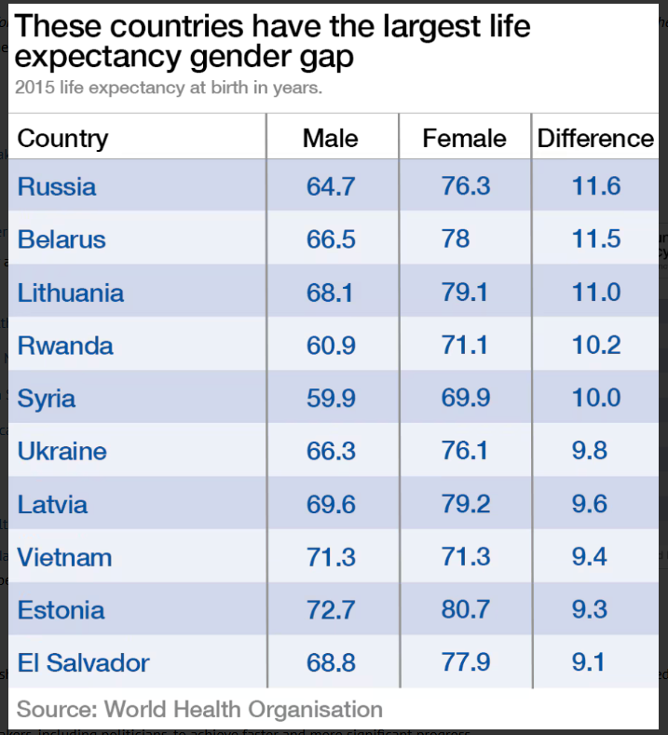
Globally, men’s health has lagged behind the health of women.

Slide 3
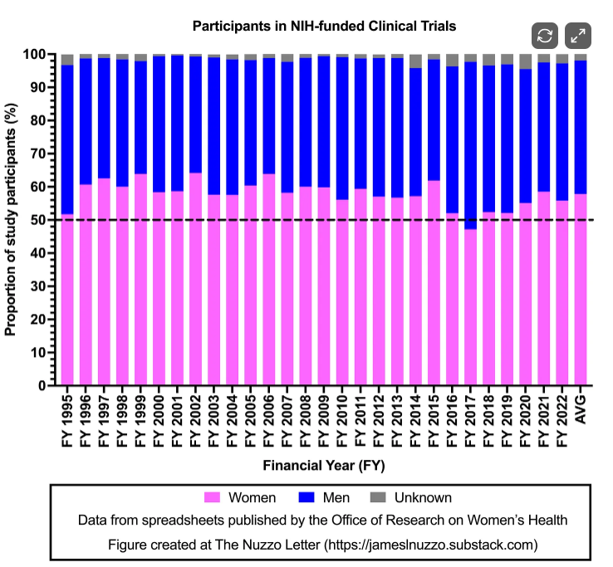
Women were not ‘excluded’ or ‘underrepresented’ in medical research
Over a 28-year period, females made up 58% of participants in NIH-funded research trials.
Source: The Nuzzo Letter, April 17, 2025

Slide 4
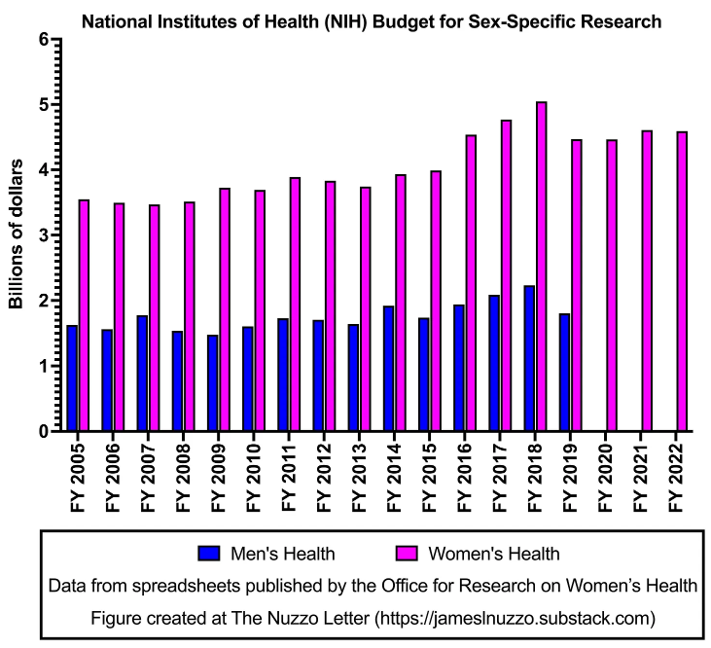
Women’s health research has received more funding than men’s health research
Women’s health research has received twice as much funding as men’s health research.
Source: The Nuzzo Letter, November 18, 2024

Slide 5
Establish country-level men’s health plans
Men’s health plans in:
1. Australia - National Men's Health Strategy
2. Brazil - National Policy of Comprehensive Healthcare to Men (PNAISH)
3. Canada – Quebec - Health and Well-Being of Men, 2017–2022
4. England - Men's Health: A Strategic Vision for England
5. Europe - Strategy on the Health and Well-Being of Men in the WHO European Region
6. Ireland - National Men's Health Policy, 2008-2013; National Men's Health Action Plan, 2017-2021; Second National Men's Health Action Plan: Healthy Ireland - Men [HI-M] 2024-2028
7. Malaysia - National Men's Health Plan of Action, 2018-2023
8. South Africa - National Integrated Men's Health Strategy, 2020-2025

Slide 6

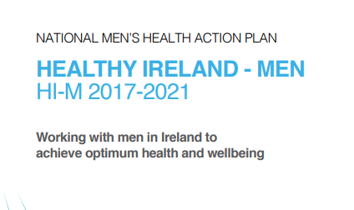

Ireland: Successive men’s health policies
1. National Men's Health Policy, 2008-2013
2. National Men's Health Action Plan, 2017-2021
3. Second National Men's Health Action Plan: Healthy Ireland - Men 2024-2028

Slide 7
Innovative aspects
The plan prioritizes mental health (including suicide and addictions), physical activity, chronic disease prevention, sexual health, and healthy ageing,
The plan aligns with broader frameworks like the Healthy Ireland Strategic Action Plan, Sláintecare, and national strategies on suicide prevention, alcohol, tobacco, sexual health, and positive ageing.
The program acknowledges that the healthcare system must adapt to become more accessible and approachable for men. Promotes initiatives like Sheds for Life (improving wellbeing and help-seeking), Farmers Have Hearts (identifying risks in 74% of participants), and Men in Mind.

Slide 8
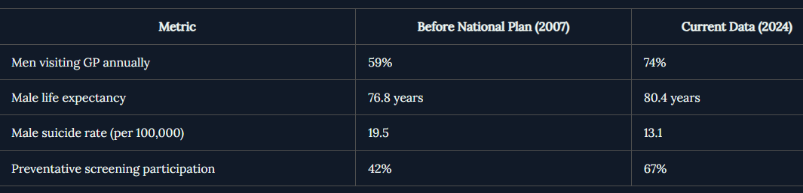
Improved health outcomes
Source: https://newsday.ie/ireland-leads-way-national-action-plan-mens-health-sets-global-precedent/

Slide 9
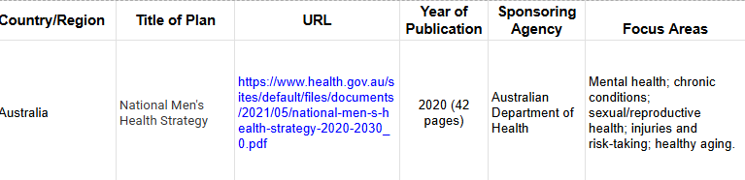
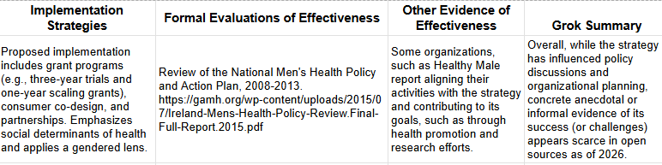
Analysis of health plans in 7 other countries
Example: Australia

Slide 10
Creating an Office of Men’s Health in the US
Legislation: State of Men’s Health Act: H.R. 7602
Coalition of Organizations:
American College of Lifestyle Medicine, Men’s Health Member Interest Group
American Men’s Health Nursing Alliance
Foundation for Male Studies
Healthy Men, Inc.
John Henry Institute on Black Men’s Health and Policy Innovation
Men Are Good
Men’s Health Program at Metropolitan State University, Denver
National Coalition for Men
SAVE
Washington Initiative for Boys and Men
Working Well With Men

