Slide 1

How to Engage with the Male Voter to Assure Election Victory
SAVE
www.saveservices.org

Slide 2
“Ignore The New Power Demographic at Your Own Risk”
Commentator Wendy mcelroy
https://mises.org/mises-wire/ignore-new-power-demographic-your-own-risk-young-male-voters

Slide 3
Outline
1. How did we get to where we are now?
2. The 2024 presidential election, and afterwards
3. Recommended strategies to secure election victory in 2026

Slide 4
1. How Did We Get to Where We are Now?

Slide 5
A Radical New Ideology
Beginning in the 1960s, a new social order arrived in America.
Based on Marxist ideology, the new ideology challenged long-accepted beliefs about marriage, manhood, and womanhood:
Men viewed as upholders of an oppressive “patriarchy”
Marriage was seen as oppressive to women: “The modern individual family is founded on the open or concealed domestic enslavement of the wife.” – Friedrich Engels, The Origin of the Family
Women urged to leave their families and devote themselves to climbing the corporate ladder

Slide 6
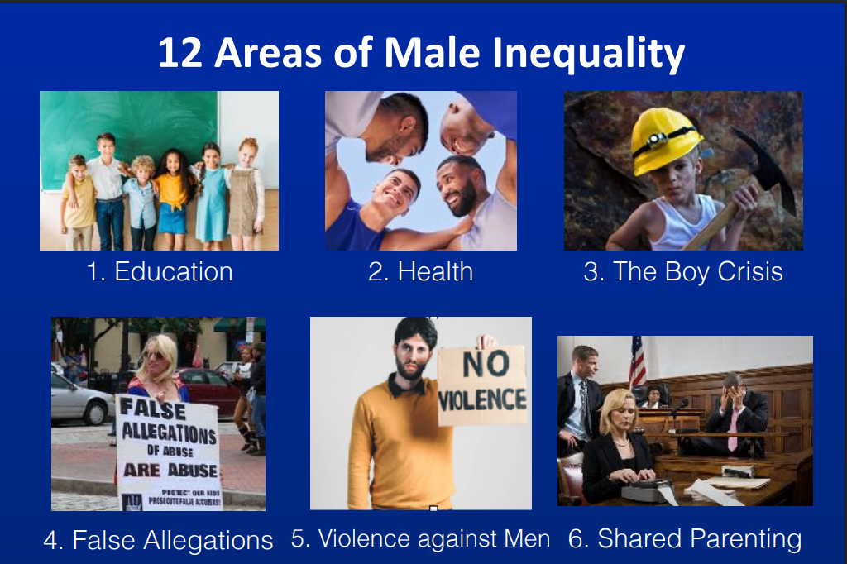
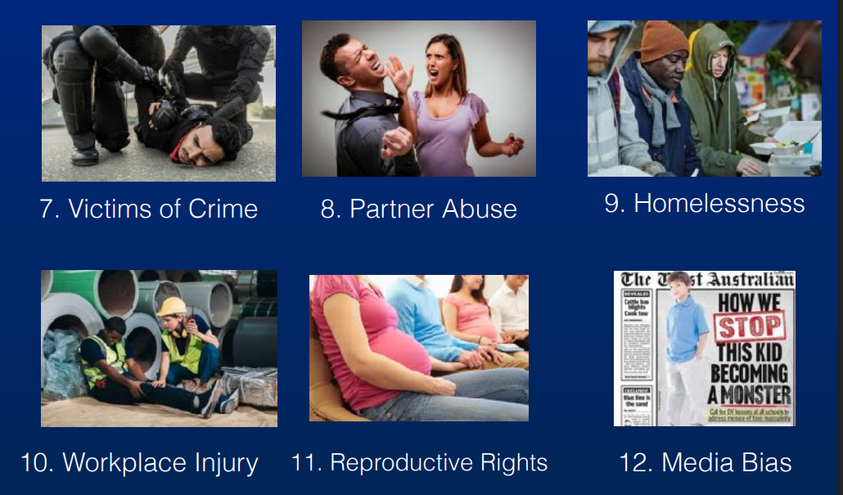
The New Order Sought to Stereotype and Marginalize Men
“Young men increasingly feel as though they have been experiencing discrimination over the past four years.” -- Elaine Kamarck and Jordan Muchnick, https://www.brookings.edu/articles/the-growing-gender-gap-among-young-people/
“We’ve blamed and shamed our boys and men. We’ve confused our boys and men. We told them they’re inherently bad and they should step aside for women. We’ve fueled resources and compassion into “girl power!” while putting our boys on the back burner.” – Lisa Britton, https://x.com/LisaBritton/status/1905600784152088854
12 areas of male inequality: www.menandboys.net --→

Slide 7
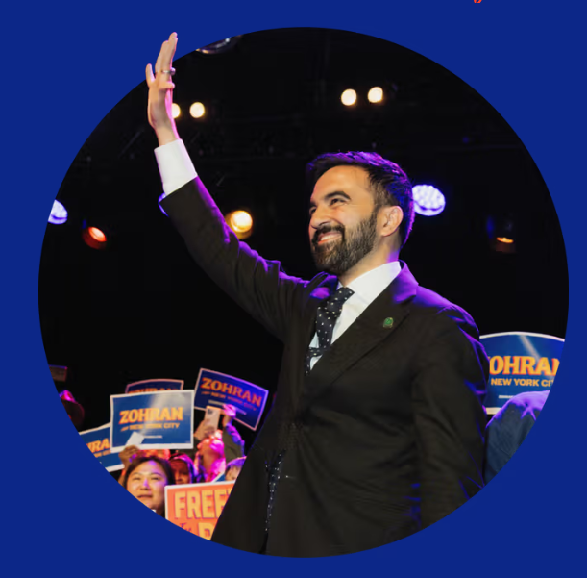
Men More Likely than Women to Embrace Free Market Values
November 5 election for New York City mayor:
-- 84% of women 18-29 years old voted for socialist Zohran Mamdani
-- The only demographic that did not support Mamdani was White men, who favored Mario Cuomo 49% to 42%.

Slide 8
Men More Likely to Embrace Pro-Family Values
1. Commitment to the Goals of Marriage: Men are more likely than women to agree that married persons are more likely to find happiness: Men: 38%; Women: 22%.
2. Parental Aspirations: Single young men are more likely than their female counterparts to aspire to become a parent. Men: 57%; Women: 45%.
3. Family Size: In response to the question, “What do you think is the ideal number of children for a family to have?”, the percentage of persons who responded, “Three or more children:” Men: 48%; Women: 37%.
4. Infidelity: Only 11% of husbands, compared to 14% of wives, had been involved in an extramarital affair, as of 2021-2022.
5. Divorce: Husbands initiate only 31 % of all divorces, while wives seek 69% of divorces.
Source: https://www.saveservices.org/2025/11/republicans-are-losing-elections-as-they-sidestep-the-male-voter/

Slide 9
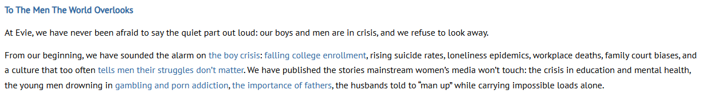
Women are Strong Supporters of Efforts to Engage the Male Electorate
Mothers are concerned that:
1. Their daughters can’t find a suitable man to marry.
2. Their son has not become engaged in a productive career.
3. Humanistic concern that men are lagging behind women in many areas – health, college attendance, homelessness, etc. See: www.menandboys.net

Slide 10
2. 2024 Victory of Donald Trump

Slide 11
How Men Voted
How men voted:
Donald Trump: 42 million men
Kamala Harris: 33 million men
While women represented 52% of the electorate, their vote was more evenly split between Trump and Harris:
55% of men voted for Trump
53% of women voted for Harris
Gender gap:
Number of cross-overs from Democratic to Republican, 2020 to 2024:
White men: 1.4 million
Hispanic men: 1.2 million
Black men: 1.1 million
Source: Catalist

Slide 12

How Did the Trump Campaign Connect with the Male Electorate?
1. Podcast and Influencer Appearances:
Trump focused on platforms with predominantly young male audiences, bypassing traditional media.
2. Targeted Messaging and Ads, Especially to Low Propensity Male Voters:
Promises to end DEI programs, and restore jobs
$20 million "Send the Vote" initiative
3. Projections of masculine strength:
Appearances at UFC (Ultimate Fighting Championship) events.
Endorsements involving figures like Hulk Hogan.

Slide 13
Subsequent Response of Democrats and Republicans
Democrats are working aggressively to capture the male vote
July 16: Former President Barack Obama said, “We rightly have tried to invest in girls to make sure that there’s a level playing field, and they’re not barred from opportunities. But we haven’t been as willing, I think, to be intentional about investing in the boys. And that’s been a mistake.”
Republicans have not been as proactive:
Charlie Kirk attributed the shortfall to the lack of a “revolutionary mindset.”
Scott McCay argued the problem is “Republicans sitting on their rear ends” while the Left is “defrosting the Cold Civil War.”

Slide 14
3. Strategies to Secure Election Victory in 2026

Slide 15
1. Promote Establishment of State-Level Councils for Men and Fathers
Existing Councils:
California: California Fatherhood Council
Connecticut: Fatherhood Initiative
Delaware: Fatherhood Program
Georgia: Commission on Men’s Health
Hawaii: Commission on Fatherhood
Illinois: Council on Fatherhood
Ohio: Commission on Fatherhood
Rhode Island: Fatherhood Initiatives
Texas: Fatherhood Resource Hub
Washington, DC: Commission on Fathers, Men, and Boys
Washington State: Washington Fatherhood Council
Wisconsin: Milwaukee Fatherhood Initiative

Slide 16
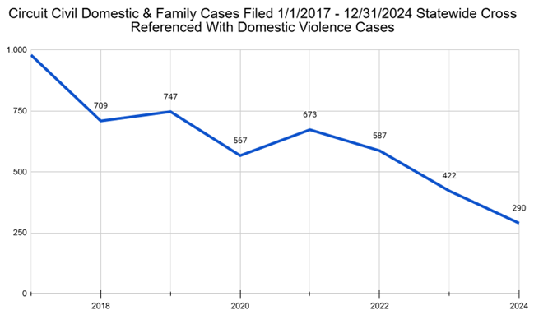
2. Promote Equal Shared Parenting Laws
2018: Kentucky became the first step to create a legal presumption of equal shared parenting in divorce cases.
Following enactment of the law, domestic violence cases have fallen by more than 70% →

Slide 17

3. Strengthen Father Involvement
Children with involved fathers have better academic, behavioral, and emotional outcomes.
Strategy: Enact legislation to establish a presumption of equal shared parenting following divorce and promote stronger father involvement.
Benefits:
Decreased child poverty
Lower child delinquency/incarceration rates
Lower welfare costs arising from teen pregnancy
Fewer foster care/Child Protective Service costs arising from less child abuse
Lost productivity/taxes from HS dropouts:
Less need for mental health treatment

Slide 18

Greater Father Involvement is One of the Highest-ROI Interventions Available
Documented benefits:
20–30% decrease in child poverty: https://www.urban.org/research/publication/poor-dads-who-dont-pay-child-support
30–40% lower delinquency/incarceration rates: https://aspe.hhs.gov/reports/incarceration-family-review-research-promising-approaches-serving-fathers-families-1
$10–15 billion savings in welfare costs arising from teen pregnancy: https://stacks.cdc.gov/view/cdc/5911
$30–40 billion in foster care/Child Protective Service costs arising from less child abuse: https://evidence2impact.psu.edu/wp-content/uploads/2023/05/s_nmfis02c02.pdf
$90–120 billion in lifetime lost productivity/taxes from High School dropouts: https://all4ed.org/wp-content/uploads/2013/06/HighCost.pdf
$15–25 billion lower mental health treatment costs: https://store.fatherhood.org/research
Conclusion: “Greater father involvement is one of the highest Return-On-Investment social interventions available”
Source: https://www.saveservices.org/2025/12/major-benefits-of-enhancing-father-involvement/

Slide 19
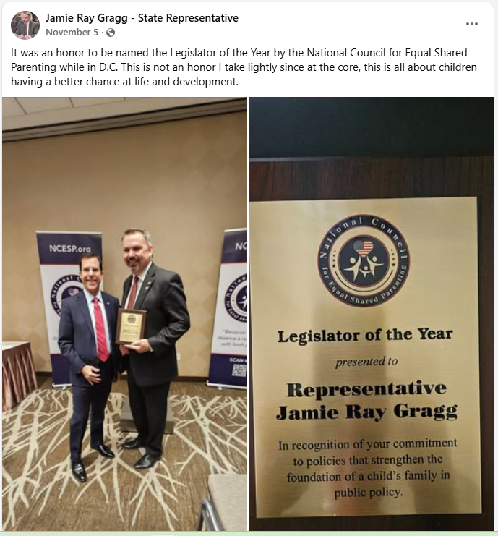
Missouri: Fatherhood Engagement Bill
Introduced by Rep. Jamie Gragg
Will support Missouri fathers who want to reestablish and strengthen their relationship with their children
Passed in the House on April 14, 2025 with strong bipartisan support: 135-11.

Slide 20
18 Other High-Impact, Low-Cost Initiatives to Engage Male Voters
In addition to establishing a presumption of equal shared parenting following divorce:
1. Adjust Child Support Laws Based on Parenting Time
2. Reinstate Recess and Free Play in Elementary Schools
3. Assure Equal Access to Domestic Violence Services for Men
4. Mandate Father Inclusion in Child Welfare and Foster Care Cases
5. Promote Vocational Pathways for High School Boys
6. Reform School Discipline Policies Disproportionately Affecting Boys
7. Public Messaging Campaign on Male Suicide and Mental Health
8. Require Public Health Departments to Report Male-Specific Health Data
9. Increase Male Teacher Representation in Early Education
10. Promote Equal Parental Leave and Flexibility for Fathers

Slide 21
High-Impact, Low-Cost Initiatives (continued)
11. Require Gender Balance on Government Gender Equality Commissions
12. Establish a “Parental Bill of Rights” for Father Inclusion in Schools
13. Incorporate Media Literacy on Male Stereotypes into School Curricula
14. Reform Campus Sexual Misconduct Procedures to Ensure Due Process
15. Set Clear Legal Standards for False Allegations
16. Facilitate Father–Child Contact in Correctional Settings
17. Decriminalize Minor School-Based Misbehavior
18. Eliminate Sex Disparities in Homelessness Services

Slide 22

More Information
Contact:
Email: info@saveservices.org
Telephone: 301-801-0608
Website:
www.saveservices.org

